Slide 1
transformation

Slide 2
introduction
The term Transformation is generally referred to as converting a graphic into another graphic by applying some rules or algorithms. Sometimes an image or picture can be a combination of lines, rectangle, circle, and triangle. If we draw and want to combine pictures, then there should be a need to transform these images. Now we can perform the following actions to transform the images-
We can change the position of an image.
We can increase or decrease the size of an image.
We can change the angle of the image.
By using the above actions, we will find a new image; this process is called Transformation. We can use some algorithms to produce new pictures.

Slide 3
The object transformation includes two important points-
Geometric Transformation: When we are moving the picture, and the background is fixed, then it is a Geometric Transformation.
Coordinate Transformation: When we are moving the background, and the picture is fixed, then it is Coordinate Transformation.

Slide 4
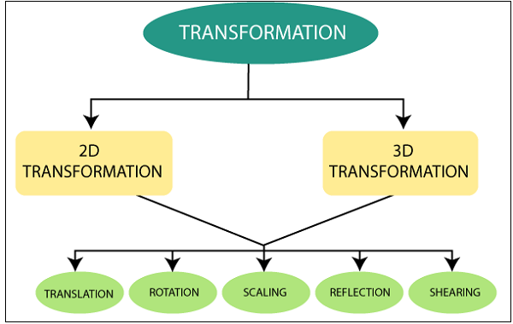
Types of Transformation

Slide 5
Two-Dimensional Transformation
2D Translation: “Translation is a mechanism used to move the object from one position to another position on the screen.”
2D Rotation: “Rotation is a process used to rotate the object from origin to a particular angle.”
2D Scaling: “Scaling is a process or technique used to resize the object in two-dimensional plane.”
2D Reflection: “Reflection is a mechanism or process in which we can rotate the object at the angle of 180°”.
2D Shearing: “Shearing is a process that is used to perform slanting on the object.” It is also called “Skewing.”
2.Three-Dimensional Transformation:
“When we translate, rotate, and scale object in the three-dimensional plane then, it is called Three-Dimensional(3D) Transformation”. A three–dimensional plane consists of x, y, and z-axis.

Slide 6
Three-Dimensional Transformation
3D Translation: “Translation is a mechanism used to move the object from one position to another position on the three-dimensional plane.”
3D Rotation: “Rotation is a process used to rotate the object from origin to a particular angle in three-dimensional plane.”
3D Scaling: “Scaling is a process or technique used to resize the object in three-dimensional plane”.
3D Reflection: “Reflection is a mechanism or process in which we can rotate the object at the angle of 180° in three-dimensional plane.”
3D Shearing: “Shearing is a process that is used to perform slanting on the object.” It is also called “Skewing”. It also includes z-axis.

Slide 7
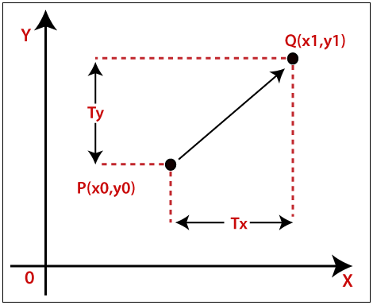
2D Translation in Computer Graphics Translation
We can move any object from one to another place without changing the shape of the object.
For Example-
Translation of a Point: If we want to translate a point from P (x₀, y₀) to Q (x₁, y₁), then we have to add Translation coordinates (Tx, Ty) with original coordinates.

Slide 8


We can also represent the translation in matrix form-
Homogeneous Coordinate Representation:
The above Translation is also shown in the form of 3 x 3 matrix-
Here, Translation coordinates (T_{x}, T_{y}) are also called “Translation or Shift Vector.”
Example– Given a Point with coordinates (2, 4). Apply the translation with distance 4 towards x-axis and 2 towards the y-axis. Find the new coordinates without changing the radius?
Solution: P = (x₀, y₀) = (2,4)
Shift Vector = (T_{x}, _{Ty}) = (4, 2)
Let us assume the new coordinates of P = (x₁, y₁)
Now we are going to add translation vector and given coordinates, then
x₁ = x₀ + T_{x} = (2 + 4) = 6
y₁ = y₀ + T_{y} = (4 + 2) = 6
Thus, the new coordinates = (6,6)

Slide 9
2D Rotation
The Rotation of any object depends upon the two points.
Rotation Point: It is also called the Pivot point.
Rotation Angle: It is denoted by Theta (?).
We can rotate an object in two ways-
Clockwise: An object rotates clockwise if the value of the Rotation angle is negative (-).
Anti-Clockwise: An object rotates anti-clockwise if the value of the Rotation angle is positive (+).

Slide 10
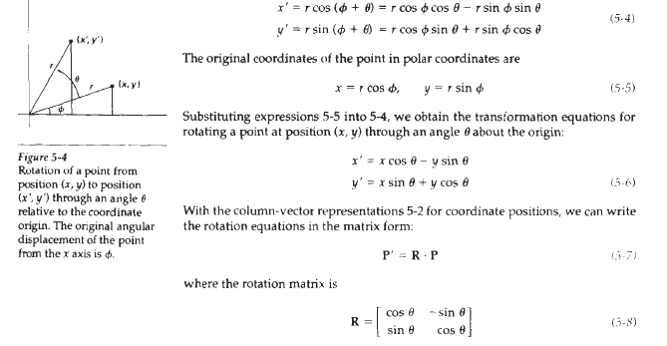

Slide 11
Example– A line segment with the starting point (0, 0) and ending points (5, 5). Apply 30-degree rotation anticlockwise direction on the line. Find the new coordinates of the line?
Solution– We can rotate the straight line by its endpoints with the same angle.
We have,
(P₀, Q₀) = (0, 0)
Rotation Angle (?) = 30°
Let the new coordinates of line = (P₁, Q₁)
We can apply the rotation matrix, then,
P₁= P₀ x cos? – Q₀ x sin?
= 5 x cos30 – 5 x sin30
= 5 x( ?3/2) – 5 x (1/2)
= 4.33 – 2.5
= 1.83
Q₁= P₀ x sin? + Q₀ x cos?
= 5 x sin30 + 5 x cos30
= 5 x (1/2) + 5 x( ?3/2)
= 2.5 + 4.33 = 6.83

Slide 12
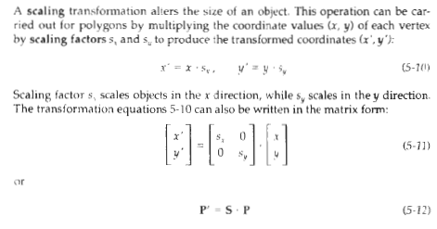
2D Scaling in Computer Graphics

Slide 13
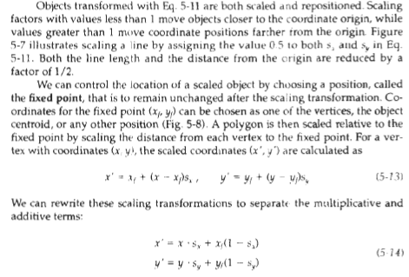

Slide 14
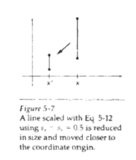
y
6
5
4
3
2
1
0
1
2
3
4
5
6
7
8
9
10
x
Note: House shifts position relative to origin

Slide 15


Slide 16

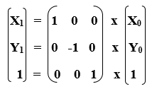
2D Reflection
Reflection along X-axis: In this kind of Reflection, the value of X is positive, and the value of Y is negative.
We can represent the Reflection along x-axis by following equation-
X­₁ = X₀
Y₁ = –Y₀
We can also represent Reflection in the form of matrix–
Homogeneous Coordinate Representation: We can also represent the Reflection along x-axis in the form of 3 x 3 matrix-

Slide 17
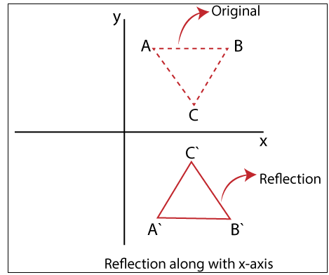

Slide 18

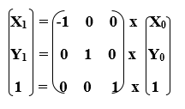
Reflection along Y-axis:
In this kind of Reflection, the value of X is negative, and the value of Y is positive.
We can represent the Reflection along y-axis by following equation-
X₁ = –X₀
Y₁ = Y₀
We can also represent Reflection in the form of matrix–
Homogeneous Coordinate Representation: We can also represent the Reflection along x-axis in the form of 3 x 3 matrix-

Slide 19
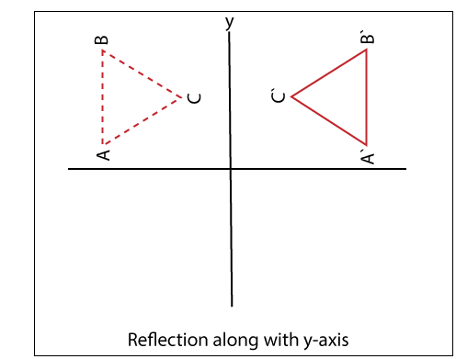
REFRECTION ALON Y-AXIS

Slide 20

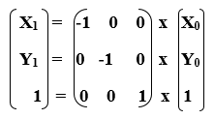
3. Reflection perpendicular to XY plane:
In this kind of Reflection, the value of both X and Y is negative.
We can represent the Reflection along y-axis by following equation-
X₁ = –X₀
Y₁ = –Y₀
We can also represent Reflection in the form of matrix–
Homogeneous Coordinate Representation: We can also represent the Reflection along with x-axis in the form of 3 x 3 matrix-

Slide 21
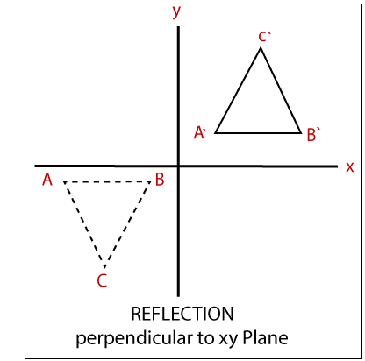

Slide 22
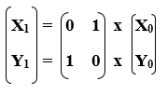
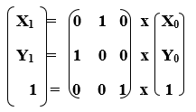
Reflection along with the line
In this kind of Reflection, the value of X is equal to the value of Y.
We can represent the Reflection along y-axis by following equation-
Y=X, then the points are (Y, X)
Y= –X, then the points are (–Y, –X)
We can also represent Reflection in the form of matrix–
Homogeneous Coordinate Representation: We can also represent the Reflection along with x-axis in the form of 3 x 3 matrix-

Slide 23
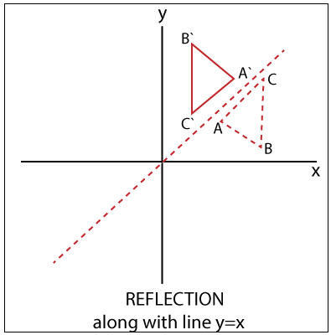

Slide 24

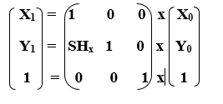
2D Shearing
We can denote shearing with ‘SH_{x}’ and ‘SH_{y}.’ These ‘SH_{x}’ and ‘SH_{y}’ are called “Shearing factor.”
We can perform shearing on the object in two ways-
Shearing along x-axis: In this, wecan store the y coordinate and only change the x coordinate. It is also called “Horizontal Shearing.”
We can represent Horizontal Shearing by the following equation-
X₁ = X₀ + SH_{x}. Y₀
Y₁ = Y₀
We can represent Horizontal shearing in the form of matrix–
Homogeneous Coordinate Representation: The 3 x 3 matrix for Horizontal Shearing is given below-

Slide 25
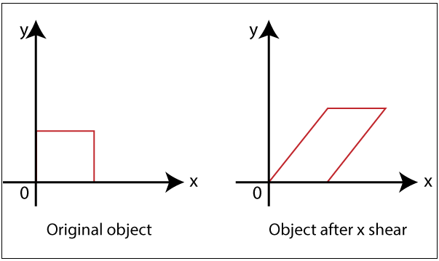
Shearing along x-axis

Slide 26

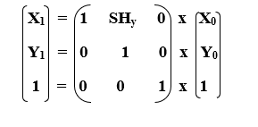
Shearing along y-axis:
In this, wecan store the x coordinate and only change the y coordinate. It is also called “Vertical Shearing.”
We can represent Vertical Shearing by the following equation-
X₁ = X₀
Y₁ = Y₀ + SH_{y}. X₀
We can represent Vertical Shearing in the form of matrix–
Homogeneous Coordinate Representation: The 3×3 matrix for Vertical Shearing is given below-

Slide 27
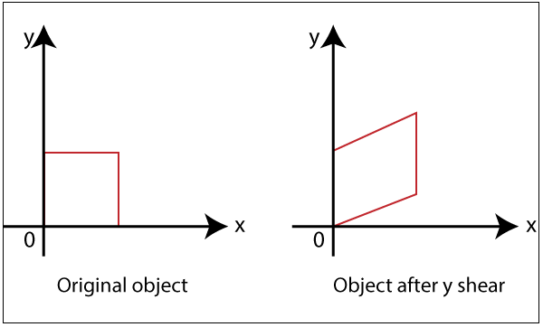
Shearing along y-axis

Slide 28
Example: A Triangle with (2, 2), (0, 0) and (2, 0). Apply Shearing factor 2 on X-axis and 2 on Y-axis. Find out the new coordinates of the triangle?
Solution: We have,
The coordinates of triangle = P (2, 2), Q (0, 0), R (2, 0)
Shearing Factor for X-axis = 2
Shearing Factor for Y-axis = 2
Now, apply the equation to find the new coordinates.

Slide 29
Shearing for X-axis:
For Coordinate P (2, 2)-
Let the new coordinate for P = (X₁, Y₁)
X₁ = X₀ + SH_{x}. Y₀ = 2 + 2 x 2 = 6
Y₁ = Y₀ = 2
The New Coordinates = (6, 2)
For Coordinate Q (0, 0)-
Let the new coordinate for Q = (X₁, Y₁)
X₁ = X₀ + SH_{x}. Y₀ = 0 + 2 x 0 = 0
Y₁ = Y₀ = 0
The New Coordinates = (0, 0)
For Coordinate R (2, 0)-
Let the new coordinate for R = (X₁, Y₁)
X₁ = X_{­0} + SH_{x}. Y₀ = 2 + 2 x 0 = 2
Y₁ = Y₀ = 0
The New Coordinates = (2, 0)
The New coordinates of triangle for x-axis = (6, 2), (0, 0), (2, 0)

Slide 30
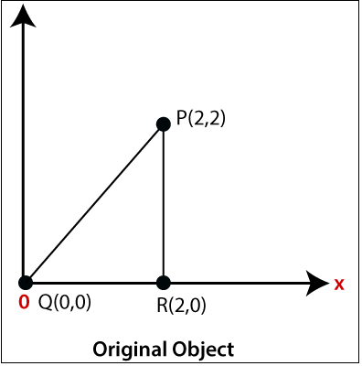
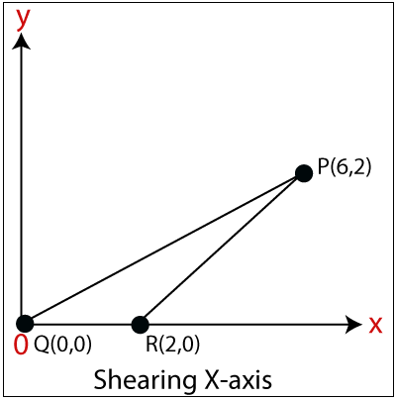

Slide 31
Shearing for y-axis:
For Coordinate P (2, 2)-
Let the new coordinate for P = (X₁, Y₁)
X₁ = X₀ = 2
Y₁ = Y₀ + Sh_{y}.X₀ = 2 + 2 x 2 = 6
The New Coordinates = (2, 6)
For Coordinate Q (0, 0)-
Let the new coordinate for Q = (X₁, Y₁)
X₁ = X₀ = 0
Y₁ = Y₀ +Sh_{y}. X₀ = 0 + 2 x 0 =0
The New Coordinates = (0, 0)
For Coordinate R (2, 0)-
Let the new coordinate for R = (X₁, Y₁)
X₁ = X₀ = 2
Y₁ = Y₀ + Sh_{y}. X₀ = 0 +2 x 2 = 4
The New Coordinates = (2, 4)
The New coordinates of triangle for y-axis = (2, 6), (0, 0), (2, 4)

Slide 32
